Slide 1

Movie Recommendation Systems
By Collin Seebeck

Slide 2
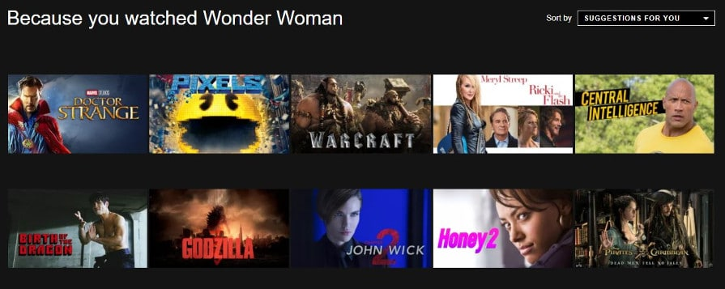
What is a Recommendation System?
A Recommendation System is software that analyzes data so that it can make predictions for things that a user might enjoy
Recommendation systems are in everything we do nowadays
A few examples of companies that use recommendation systems are Amazon, Youtube, Netflix, and even Tinder
Can you think of any other companies that use recommendation systems?
Slide 1

Slide 3
Types of Recommendation Systems
There are four main types of recommendation systems:
Content Based – system takes attributes of product/s that the user likes and suggests other products with similar attributes
For Example: If I go onto Amazon and buy a hammer. Amazon might suggest that I buy other hammers, screws, or wrenches because they are all tools
Collaborative Based – within collaborative based systems there are actually multiple recommendation systems: item-item based and user-item based filtering
Item-item based filtering - looks at items users have already purchased / used in the past and recommends similar items (Amazon)
Similar items - in this model are measured by how similarly they are rated by users
User-item based filtering - groups users together based on whether or not they share similar habits and recommends products to users based on what other users in their group enjoyed
Comparison: Both very effective algorithms. Item-item based filtering is less resource and time intensive and is easier to use on new customers.
Popularity Based – recommends the most popular products
Hybrid – combination of two or more of the systems above
Slide 2

Slide 4
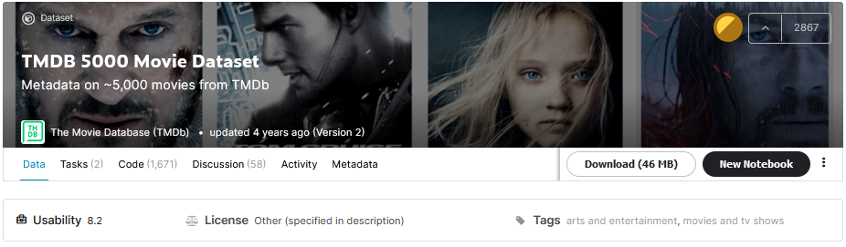
About the Data Content Based
Data Source: https://www.kaggle.com/tmdb/tmdb-movie-metadata
Two csv files (Movies and Credits)
20 columns in the Movies csv: genres, keywords, language, etc. . .
3 columns in the Credits csv: movie_id, title, cast
Data Limitations
Only about 5,000 movies in the dataset
Only goes up to 2017
Slide 3

Slide 5
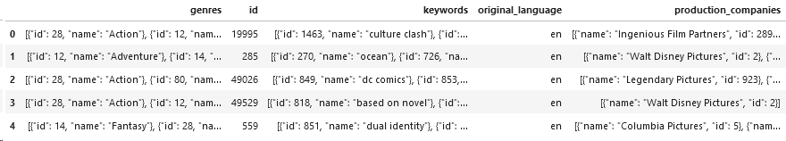
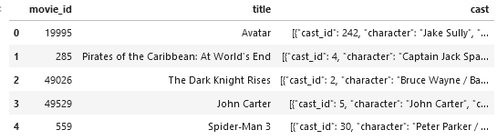
Starting Data Content Based
Movies CSV
Credits CSV
Slide 4

Slide 6
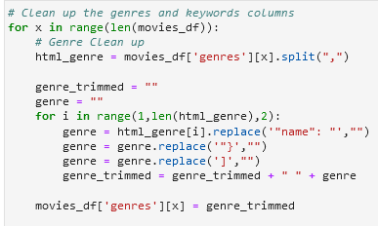
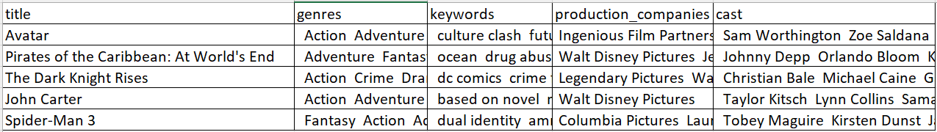
Cleaning the data Content Based
Sample Python Code
Clean Dataset
Slide 5

Slide 7


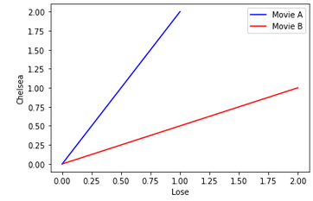

Finding Similarity 1 Content Based
Import Dependencies
Finding Similarity Code
Example:
Text from Movie A: Chelsea Lose Chelsea
Text from Movie B: Lose Chelsea Lose
Using CountVectorizer.fit_transform and let's say Lose is X and Chelsea is Y it becomes
Movie A (1,2)
Movie B (2,1)
Then cosine similarity simply finds the value of cos(θ)
The smaller the angle the more similar the movies are
The smaller the angle the larger cos is. cos(0) = 1 cos(90)=0
θ
Slide 6

Slide 8
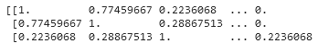
Finding Similarity 2 Content Based
Cosine Similarity Matrix Example
Ran same code to generate a cosine similarity matrices for:
Keywords,
Cast, and
Production Companies
Calculating Total Cosine
θ
Let's Test Out the Model
Slide 7

Slide 9
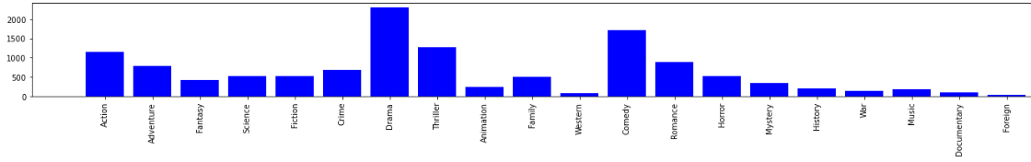
Evaluate the Model Content Based
Unsupervised Machine Learning Model
No defined right or wrong recommendation
How many of the genres from the recommended movies match the genres in the original movie
Example: Movie A genres: Action, Fantasy, and Drama
Recommended Movies based on Movie A genres: Action, Fantasy, Drama, and Thriller
This would be 3 correct and 1 incorrect
Chose not to look at any other columns because there is too much variation in them
θ
Slide 8

Slide 10
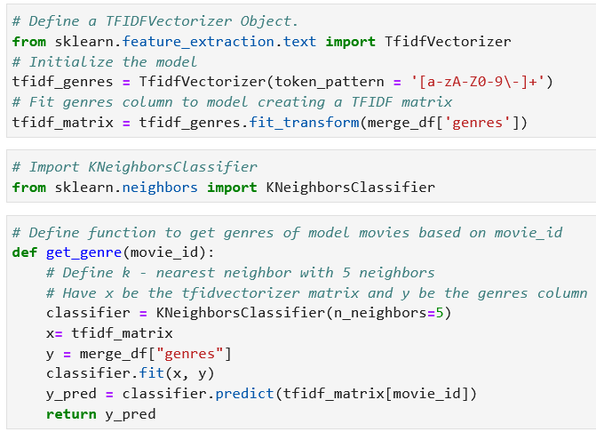
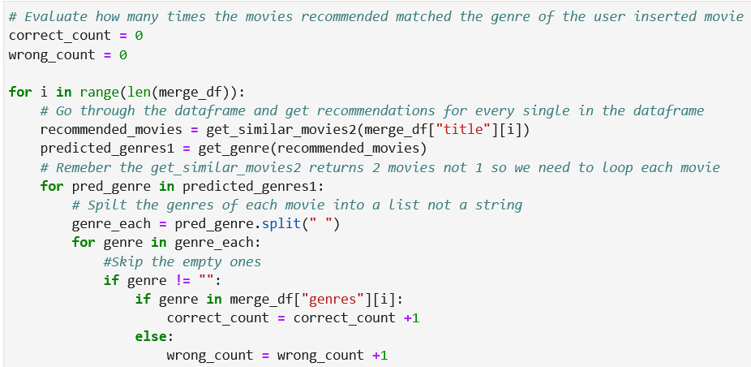
Evaluate the Model 2 Content Based
TF-IDF – Term Frequency Inverse Document Frequency
Term Frequency – How many times a word appears in a document
Inverse Data Frequency – how important is a word
Commonly used to transform text so that it can be used in algorithms / calculations
Used TF-IDF so that text could be used in K – Neighbors Classifier
θ
Slide 9

Slide 11
Results / Conclusions Content Based
Conclusions
Like mentioned earlier, since this is an Unsupervised Machine Learning Model it is very difficult to evaluate the successfulness of it.
There are no real “correct” recommendations so it is impossible to get an R-score or any other objective metrics
This method of evaluating the predicted movies’ genres match the base movie genre is not the only possible way to evaluate the model but it is an effective way to judge the model
Using this model to evaluate the recommendation system the Content Based Recommendation System proves to be very effective at predicting movies with matching genres with a 92% success rate
θ
Total Data for Entire movies.csv Dataset
Number of Genres | Number Correctly Predicted | Number Incorrectly Predicted
24,318 | 22,447 (92.3%) | 1,871 (7.7%)
Slide 10

Slide 12

About the Data Collaborative Based
Data Source: https://grouplens.org/datasets/movielens/latest/
There are two zip folders on this link, download the larger zip folder ml-latest.zip
There are multiple csv files in this zip file. Only use movies.csv and ratings.csv in this project
3 columns in movies.csv: movieId, title, and genres
3 columns in ratings.csv: userId, movieId, and rating
Merged Dataset Information
Number of Rows 1,048,575
Number of Movies 22,156
Number of Users 10,532
Slide 11

Slide 13
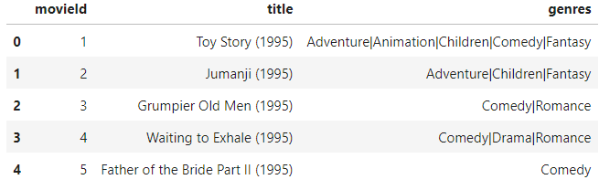
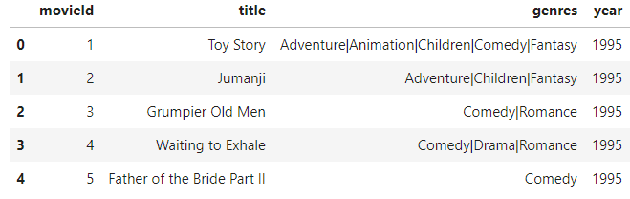
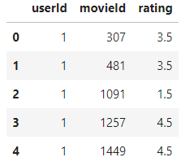
Starting Data Collaborative Based
Movies CSV
Cleaned Movies CSV
Ratings CSV
Slide 12

Slide 14
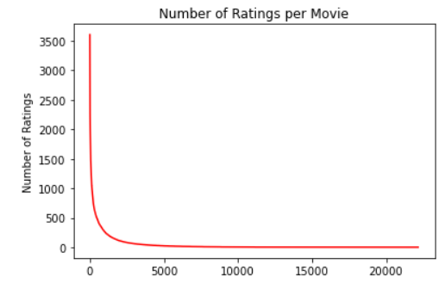
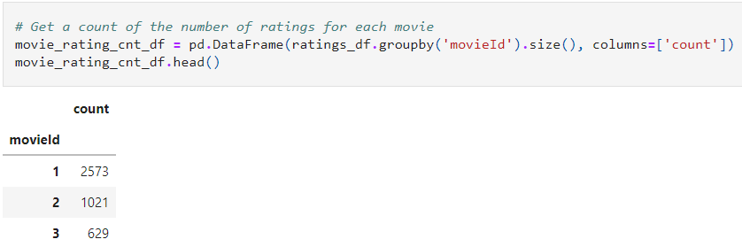
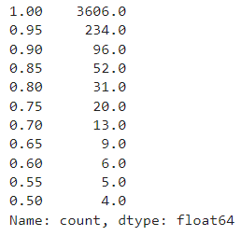
Number of Ratings per Movie Collaborative Based
Plot
Get count of number of ratings per movie
Top 1% of movies have more than 3,600 ratings
Top 5% of movies have more than 230 ratings
Half the movies have less than 4 ratings
Based on this I am going to remove all movies with less than 10 ratings
So I removing approximately 65% of the data
There are 5,419 movies with 10 or more ratings. There were 22,156 in the original dataset.
Quantiles
Slide 13

Slide 15
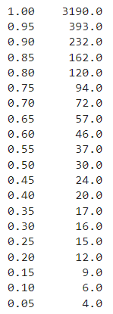
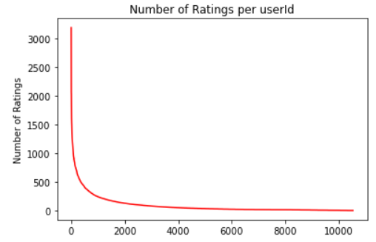
Number of Ratings per User Collaborative Based
The plot for Number of Ratings per userId is very similar to the plot for Number of Ratings per Movie
There are a select few number of users that have rated a very high number of movies. Outside of these users, all the rest of the users did not rate very many movies at all.
To keep it kind of standard and not remove too many users. Remove all users who have rated less than 10 movies
This is approximately 15% of all the users
There are 8,701 users that have rated 10 or more different movies. There were 10,532 users in the original dataset.
Slide 14

Slide 16
Number of Ratings per User Collaborative Based
The plot for Number of Ratings per userId is very similar to the plot for Number of Ratings per Movie
There are a select few number of users that have rated a very high number of movies. Outside of these users, all the rest of the users did not rate very many movies at all.
To keep it kind of standard and not remove too many users. Remove all users who have rated less than 10 movies
This is approximately 15% of all the users
There are 8,701 users that have rated 10 or more different movies. There were 10,532 users in the original dataset.
Slide 15

Slide 17
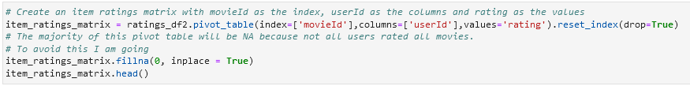
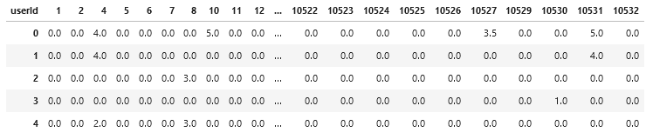
Pivot Table Collaborative Based
Generate Pivot Table
Pivot Table
Slide 16

Slide 18
Conclusions
Content Based Recommendation System
Overall effective system at recommending movies solely on content
Many limitations:
Lack of movies (number and only goes up to 2017)
User preferences not considered
Popularity not consider
Collaborative Based Recommendation System
Unfortunately, I was unable to finish this recommendation system
I was able to clean the data, and create pivot tables so this code can be used as a starting point for future projects
Slide 16

